Slide 1
Database Design and Implementation
Task 6 Presentation by group 23

Slide 2
Table of contents
01
02
03
04
05
Introduction and Data Elements
Conceptual Design
ER Diagram
Database and Backend Implementation
Connecting DB to backend

Slide 3
NTUV TCHAPTSA JAMISON LII
INTRO and DATA ELEMENTS

Slide 4
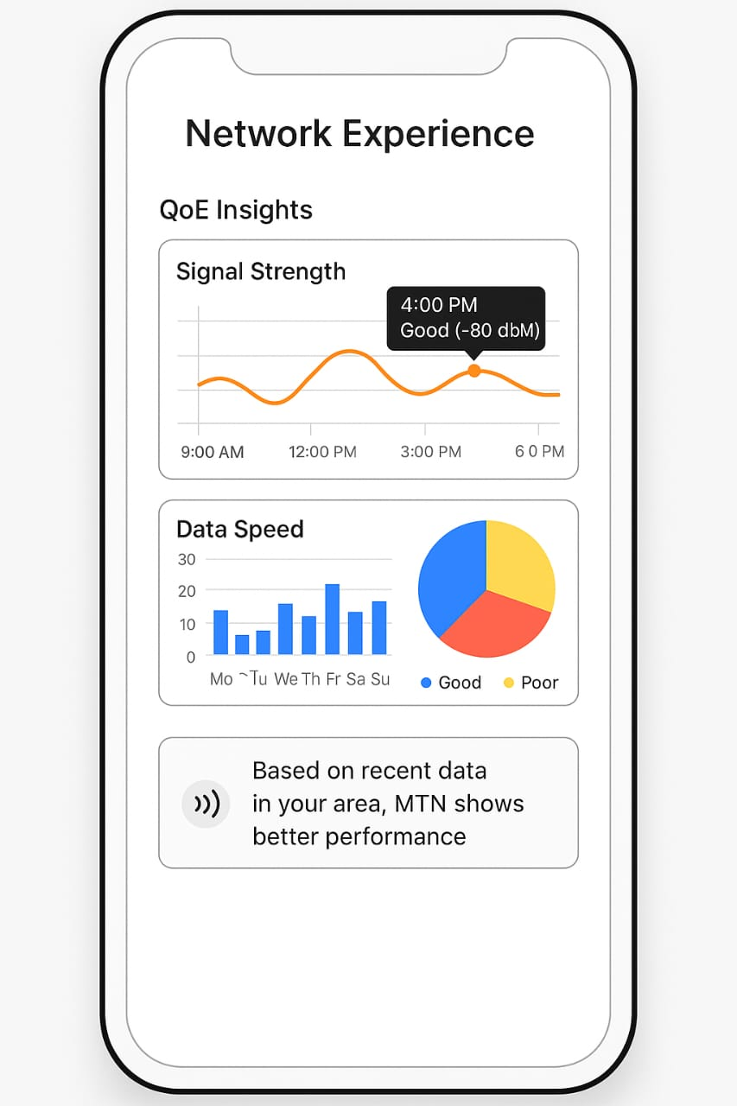
Introduction and Data elements
User info(name , email, device id)
Network feedback(rating, comment, timestamp)
Network metrics (download speed, signal strength, latency)
Location data
History logs

Slide 5

CONCEPTUAL DESIGN
MBIGHA KINENUI STEPH

Slide 6
Conceptual Design
The table below gives a summary of our visual design
1 | Core entities: User , Network metrics, feedback
2 | Device_id helps link anonymous data
3 | Data flows from device and local storage and backend

Slide 7
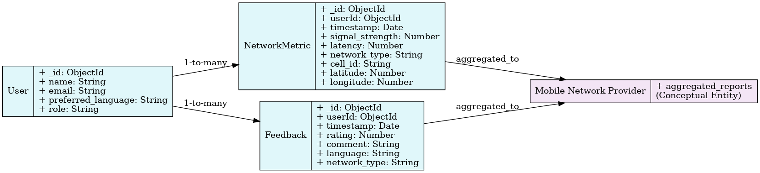
Concept

Slide 8
NGANYU BRANDON
ER DIAGRAM

Slide 9
ER DIAGRAM Overview
1) ERD shows one to many relationships (user and Metrics/feedback
2)Each metric can belong to either anonymous (device_id) or logged-in user
3)MongoDB is schemaless but we apply structured logic

Slide 10
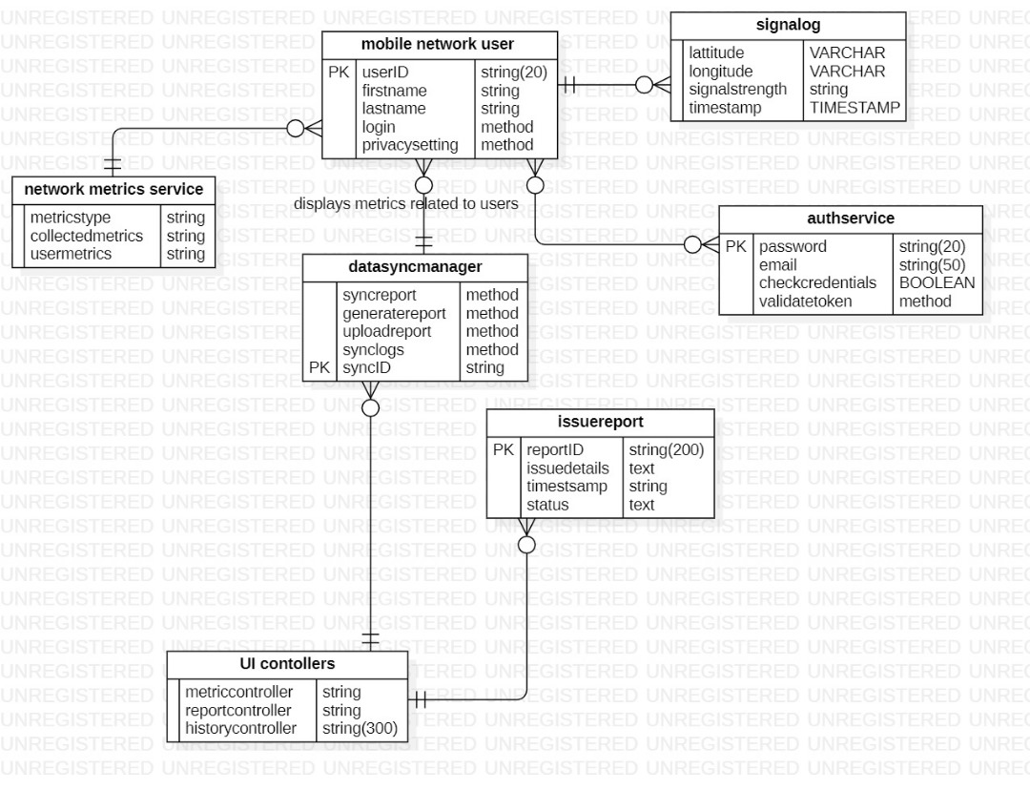
ER DIAGRAM

Slide 11
TIAYA FOTSEU JOSUE
Database and Backend Implementation

Slide 12
How did we come up with the database?
Step 1
Step 2
Step 3
Selected the appropiate db which is mongodb
Created a cluster and a database with mongo db
Specified the different colletions and fields
Step 4
Supports API for data deletion or export
Uses secure background tasks and permission handling
Wrote the backend code with nodejs

Slide 13
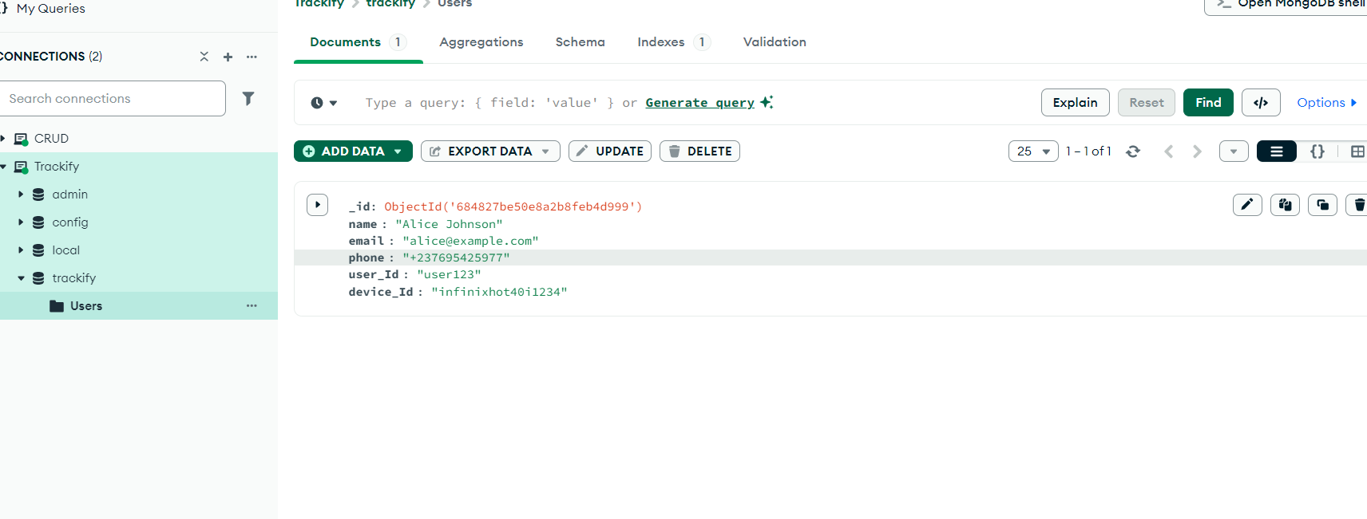
DB image

Slide 14
NGULEFAC THEODORE
Connecting DB to Backend

Slide 15
Connecting database to the backend
2)Anonymous data is tagged with device_id
1)Backend exposes RESTful APIs for metrics and feedback
3)On login backend links existing data to user_id

Slide 16
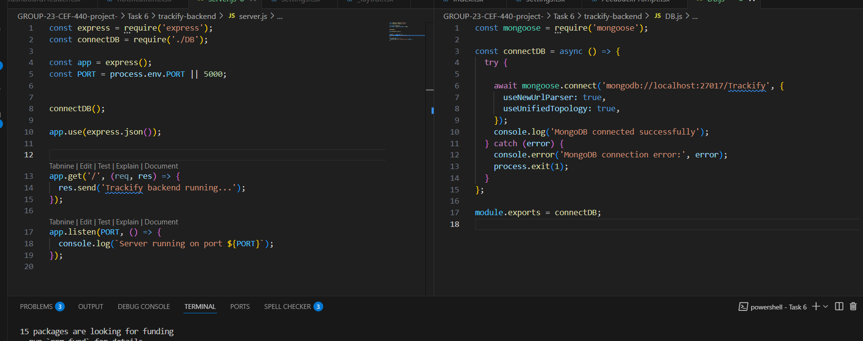
Backend configuration

Slide 17

Thanks!
Do you have any questions?

